Slide 1
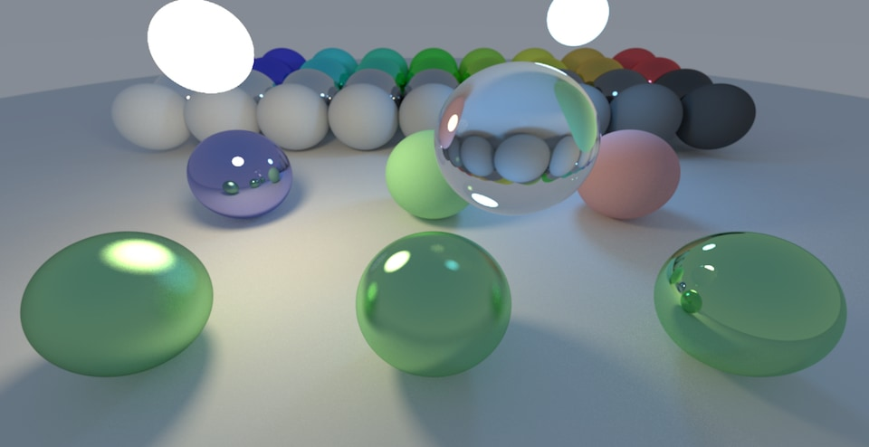
3D Rendering : Path Tracer
CSCI 596
Project Presentation
CSCI 596 : Scientific Computing and Visualization
Fall 2023
Sneha Bandi

Slide 2
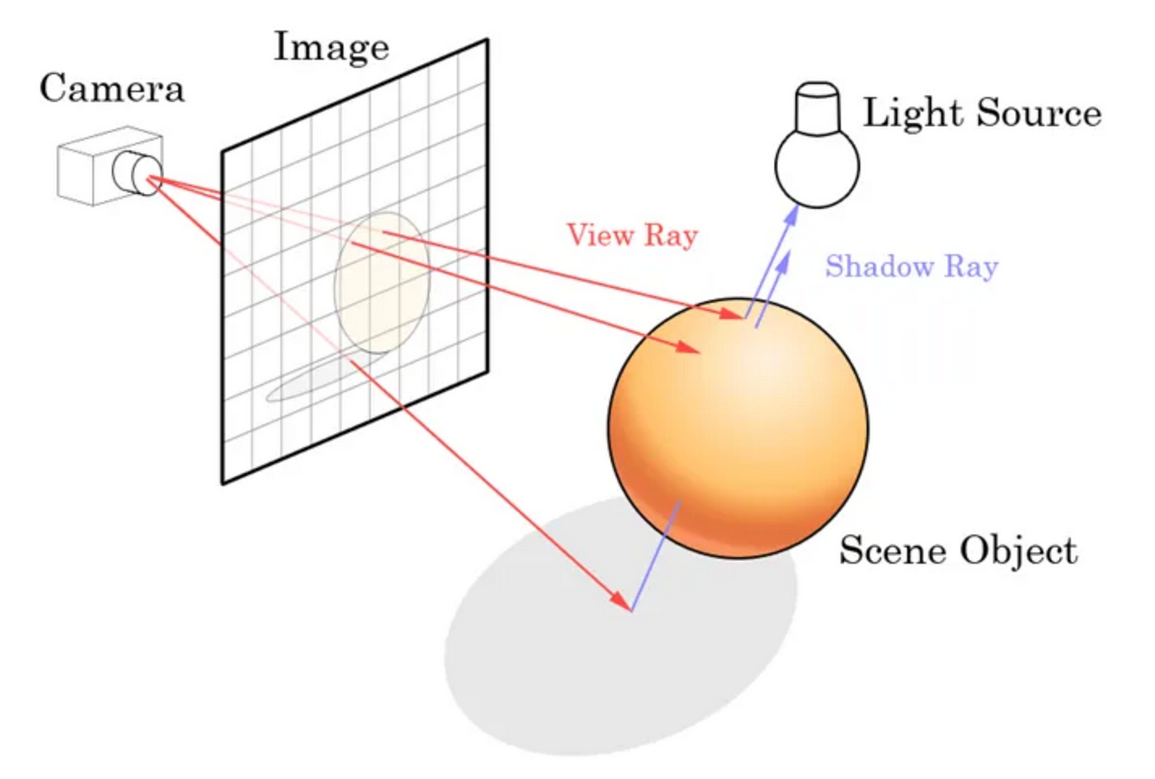
What is a Path Tracer?
A Path Tracer is a 3D rendering technique used in computer graphics to simulate the way light interacts with surfaces in a 3D scene.
It is a global illumination algorithm that models the realistic behavior of light by tracing the paths of light rays as they travel through a virtual environment.
The primary goal of path tracing is to produce visually realistic images by simulating the complex interactions of light with different surfaces, materials, and objects.
Path tracers are used for creating photorealistic images and animations in applications such as film production, architectural visualization, and scientific visualization.

Slide 3
Problem
Rendering realistic 3D scenes involves simulating the complex behavior of light as it interacts with surfaces and materials.
The traditional rendering equation captures this phenomenon, but it's recursive nature makes it challenging to solve directly, necessitating numerical approximation methods like Monte Carlo.
Path tracing is particularly effective in capturing realistic lighting scenarios, including effects like soft shadows, caustics, and color bleeding. However, it can be computationally intensive, and require optimizations
Notes:
Rendering realistic 3D scenes involves simulating the complex behavior of light as it interacts with surfaces and materials. The traditional rendering equation captures this phenomenon, but it's recursive nature makes it challenging to solve directly, necessitating numerical approximation methods.
Path tracing is particularly effective in capturing realistic lighting scenarios, including effects like soft shadows, caustics, and color bleeding. However, it can be computationally intensive, and require optimizations, such as importance sampling and various heuristics.

Slide 4
Objective
The planned objective of this project is to develop a high-performance Path Tracer in C++ to address the challenges of rendering 3D scenes. Path Tracing, a cutting-edge technique, will be employed to simulate light interactions accurately.
The solution includes implementing robust ray tracing, advanced rendering features, and optimization for real-time rendering, catering to scientific computing and visualization needs.

Slide 5
Motivation
Why Scientific Computing and Visualization?
Scientific Visualization: Accurate representation of complex scientific phenomena.
Monte Carlo Technique: Essential in scientific computing for numerical approximation.
Why Path Tracer?
Realism in Visualization: Path Tracing provides a realistic approach for visualizing scientific data and simulations.
Photorealistic Rendering: Aids researchers in creating visually compelling images.

Slide 6
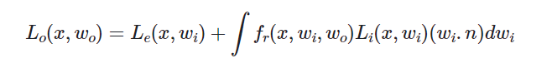
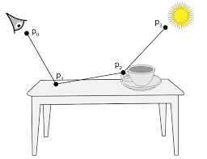
Background and Mathematical Explanation
Path Tracing and the Rendering Equation
The rendering equation mathematically represents light interactions in 3D scenes
It shows amount of light sent out from a point in a given direction.
Numerical approximation methods are required due to the equation's recursive nature.
Bidirectional Reflection Function (BRDF)
The function f_{r}(x₀,w_{i},w₀) is the "Bidirectional Reflection Function".
The Bidirectional Reflection Function (BRDF) determines how much light is sent out in a specific direction.
It governs how much of the light received at the point x from direction w_{i}is sent out in direction w₀.

Slide 7
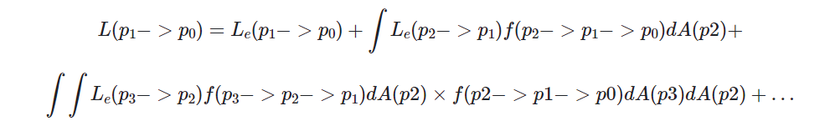
Background and Mathematical Explanation
Monte Carlo Technique
Monte Carlo Techniques: Key in sampling points efficiently for approximation
Widely used for approximating complex mathematical expressions.
Heuristics are used to select "good points" for accurate approximation.
Balancing accuracy with computational efficiency is crucial.
Reformulated Rendering Equation
The reformulated equation expresses light as a sum of contributions from rays of increasing length.
Randomly generating and accumulating ray paths is essential for realistic rendering.

Slide 8
Experiment Design and Implementation
Implementation of a C++ program considering the recursive nature of the rendering equation.
Integration of relevant libraries for geometry representation, shading, and acceleration.
Monte Carlo Integration: Implementation for efficient sampling.
Detailed Experimentation with path tracing

Slide 9
Evaluation Metrics
Visual Quality: Comparison against reference images to assess realism and accuracy.
Performance: Detailed analysis of rendering times for complex scenes and animations.
Feature Completeness: Support for various materials, camera models, and light sources.
Code Quality: Review for maintainability, scalability, and adherence to best practices.

Slide 10
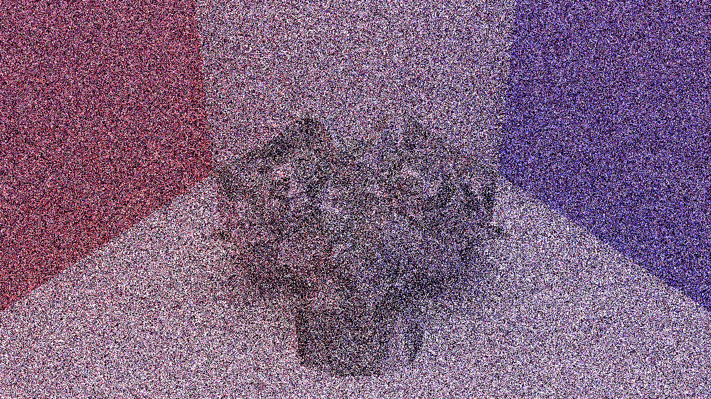
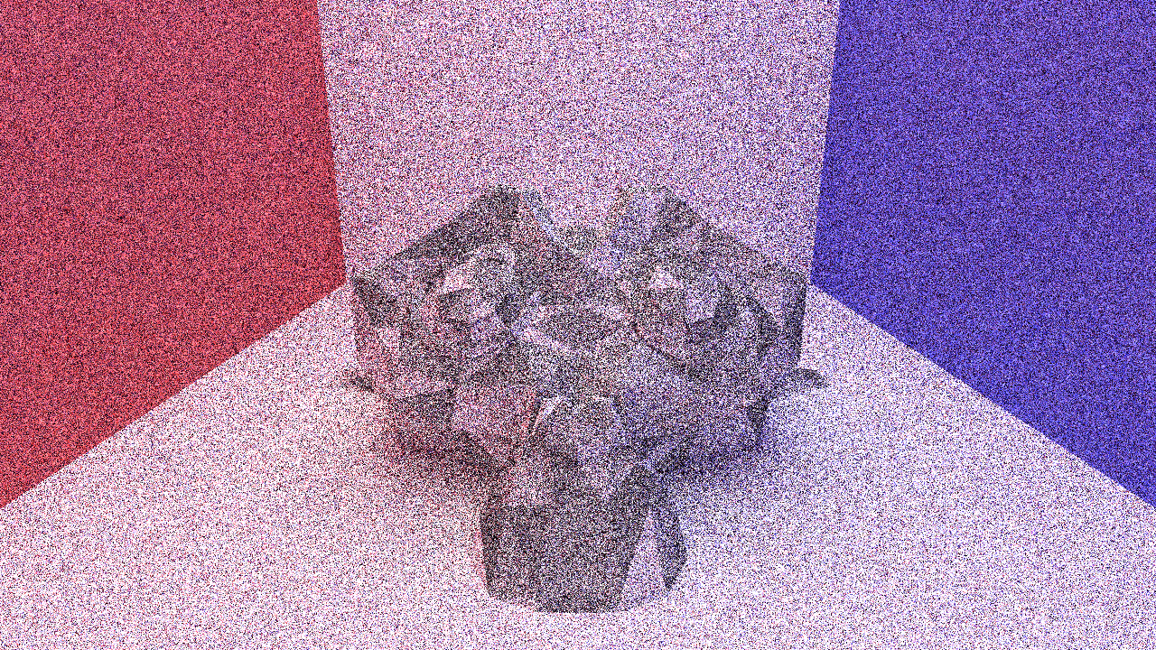
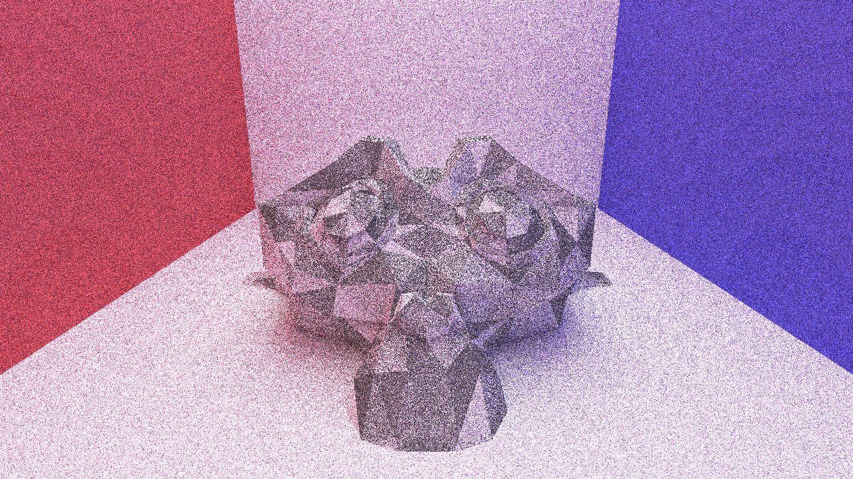
Results and Analysis
1 sample
4 samples
16 samples
Experiment to be contd. with higher sample sizes Like 128, 256, 1024 samples

Slide 11
Computational Cost and Time
Machine used:
AMD Ryzen 5700U
16 CPU cores
Threads per core: 2
Total threads: 32
Clock max: 4.3 Ghz
Clock min: 400 Mhz
Samples | Seconds elapsed
1 | 1
4 | 17
16 | 61

Slide 12
Conclusion and Future Work
The projects aimed to create a high-performance Path Tracer, aligning with scientific computing and visualization requirements. By achieving the outlined objectives and meeting evaluation criteria, the resulting tool will be valuable for in fields requiring accurate and visually compelling 3D renderings.
Future work could involve further optimizations (Like : Metropolis Light Transport), additional rendering features (Like : bidirectional path tracing), and implementation and exploration of extensions like real-time interactive rendering.

Slide 13
Thank You

